Slide 1
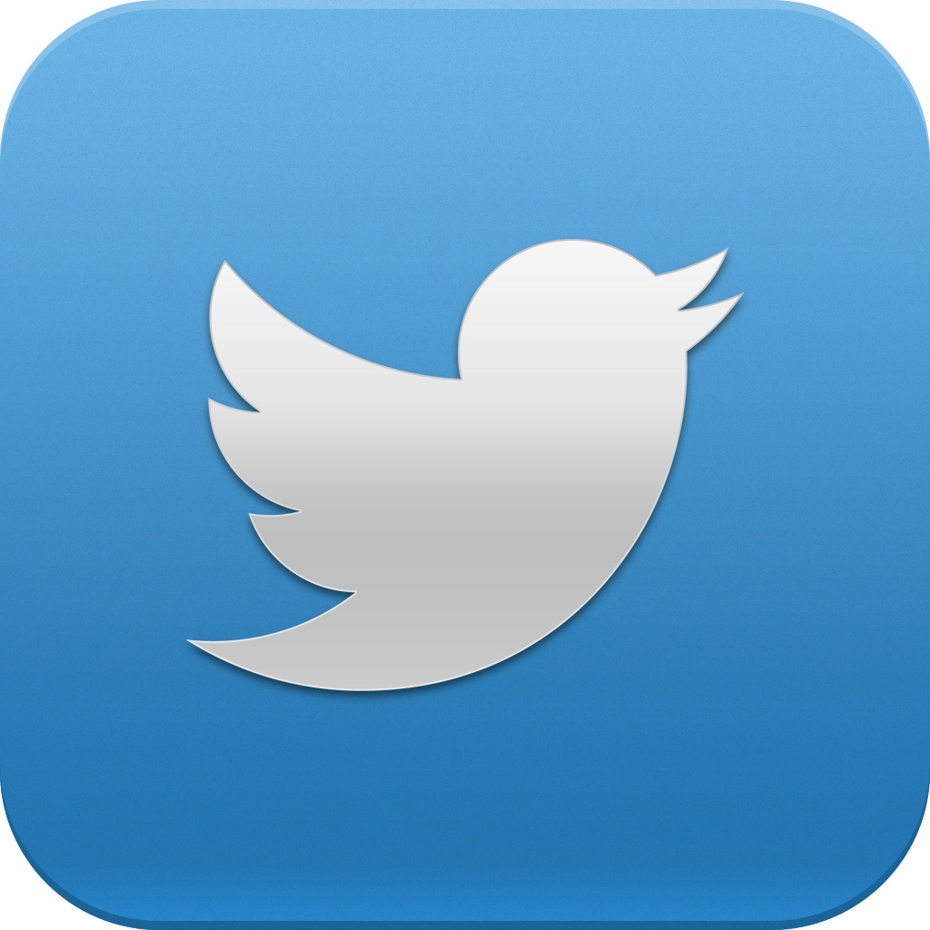
Twitter
By Sebastian and Sanjay

Slide 2
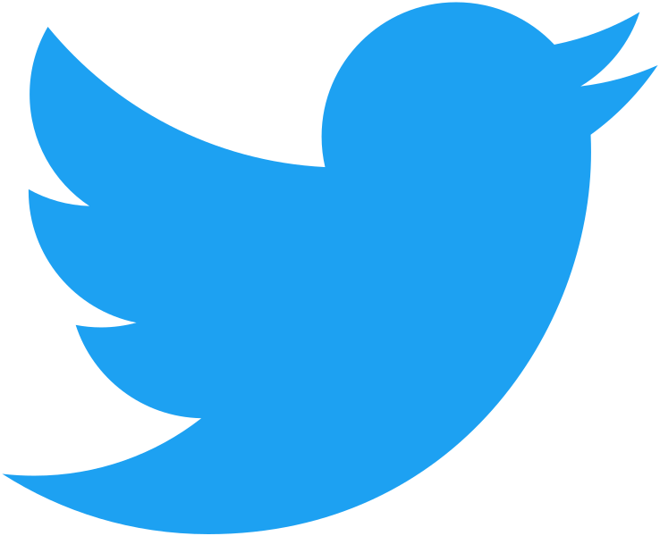
The history of twitter
Twitter began as an idea that jack Dorsey proposed to Evan Williams in 2006 which is now one of the worlds most used social media platforms.
In the early stages of twitter it was referred to as “twttr”
The software developer of twitter is Noah glass who came up with the original name twttr which then changed to twitter which is its present name.

Slide 3
Top 3 most followed people on twitter
1. Katy Perry (@katyperry) - 107million followers
2. Justin Bieber (@justinbieber) -104 million followers
3. BarackObama (@BarackObama) – 102 million followers

Slide 4
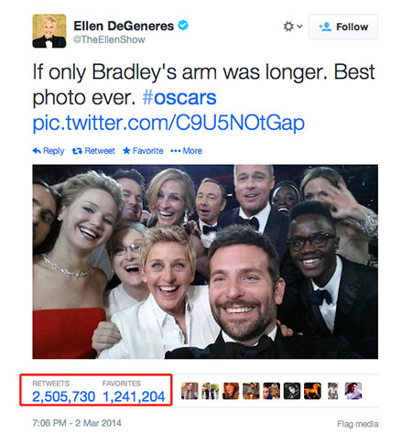
The Most Popular Tweet
The most popular tweet is on Ellen DeGeneres’ twitter. At the moment of writing this, the tweet has 2.4 million likes and 3.3 million retweets.
It is a selfie from the Academy Awards which includes Bradley Cooper, Lupita Nying’o, Jennifer Lawrence, Brad Pitt, Kevin Spacey and other extremely famous people. This post reportedly includes a product placement for Samsung’s Galaxy phone.

Slide 5
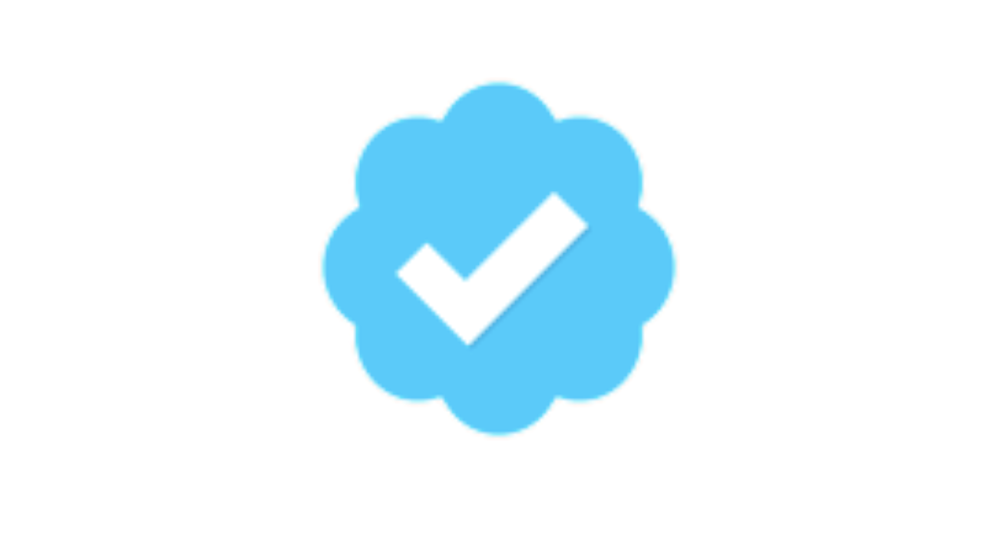
Verification
Twitter’s account verification marks profiles with a blue tick badge. It is given to famous celebrities and public figures or those at risk of impersonation.
Today there are about 305 thousand verified accounts.
Twitter’s @verified account automatically follows all verified users.

Slide 6
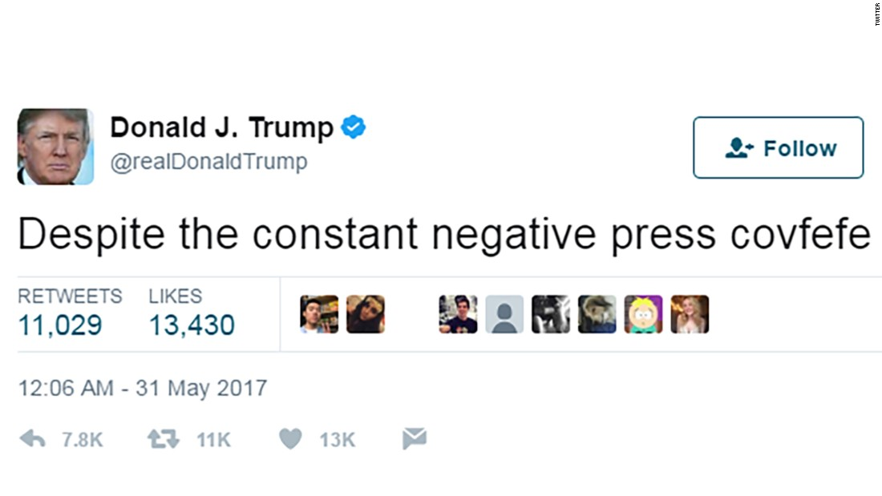
Not being able to block other users
Turns out, due to Donald Trump’s and other government officials’ twitter accounts are being considered to be public forums, blocking twitter users for their political views means violating their rights to free speech, therefore it is not allowed to block others on these accounts.

Slide 7
Random facts
The first ever tweet was posted on 21st march, 2006 by Jack Dorsey at 9:50 pm and it read: “just setting up my twttr”
Today, around 500 million tweets are dispatched into the Twitterverse every 24 hours .
There are around 200 billion tweets published in a single year.

Slide 8
Reference
https://www.entrepreneur.com/article/320417
https://www.lifewire.com/history-of-twitter-3288854
https://en.m.Wikipedia.org/wiki/Twitter
http://time.com/4263227/most-popular-tweets/
https://news.sky.com/story/trump-banned-from-blocking-twitter-users-from-his-official-account-11383459

Slide 9
Thank you for listening
By Sanjay and Sebastian

